Slide 1
Kitchen’s Helper
FINAL REPORT
Team 05
許凱傑 B03901026
陳柏文 B03901036
莊育權 B03901142

Slide 2
Outline
A. Introduction
- Applications
- Functionalities
B. Implementation
- Electronic Elements
- Hardware Architecture
C. Observation and Results
D. DEMO Time
E. Q&A

Slide 3

Notes:
有一天你同學幫你辦一個生日party，一進去你就看到，天哪，桌上是你最喜歡吃的草莓波波波提拉米蘇長條蛋糕，但這時候你突然驚鴻一瞥，發現你的同班同1學乃優子居然也在，乃優子也很喜歡吃草莓，但他是一個很自私的人，他一定會對蛋糕的大小很計較，如果太小他一定會當場生氣，你又不希望在生日會上讓大家氣氛不好，你這時候就想，如果可以有個很精準能自動幫忙切蛋糕的機器就好了

Slide 4
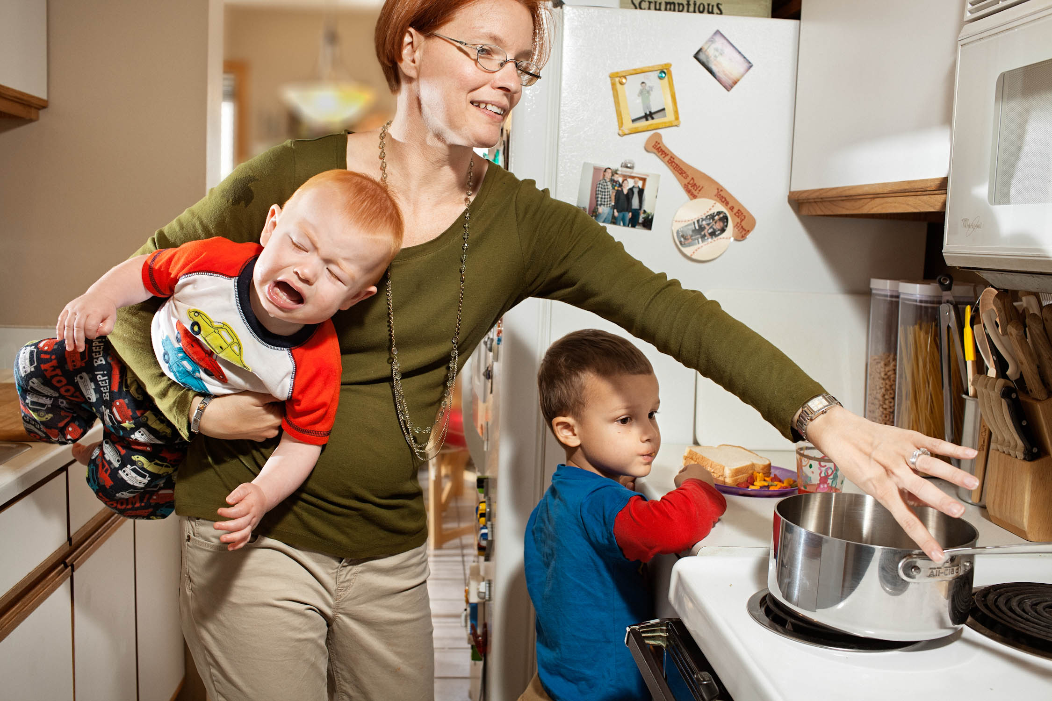
Notes:
你是個家庭主婦，每天早上下午上班，下班還要回家煮飯。而在煮飯的時候，兩個小孩，還不斷的跑來跑去，哥哥手賤還會想去碰熱鍋，你根本分身乏術，沒辦法專心切菜煮菜

Slide 5
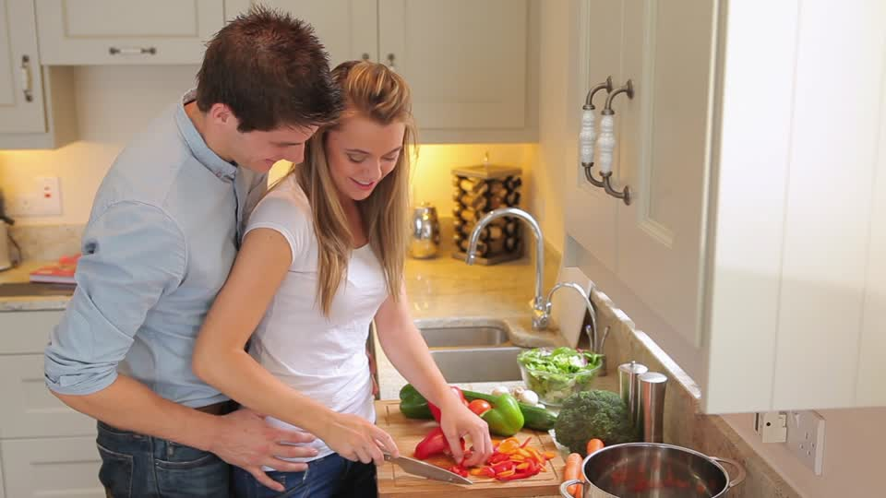
Notes:
而你那個老公，整天只會抱在你後面，說喔老婆，你切菜好性感，我們要不要生第三胎，然後他也不顧小孩，這時候你就想，要是有個可以幫我自動切菜的機器該有多好啊

Slide 6
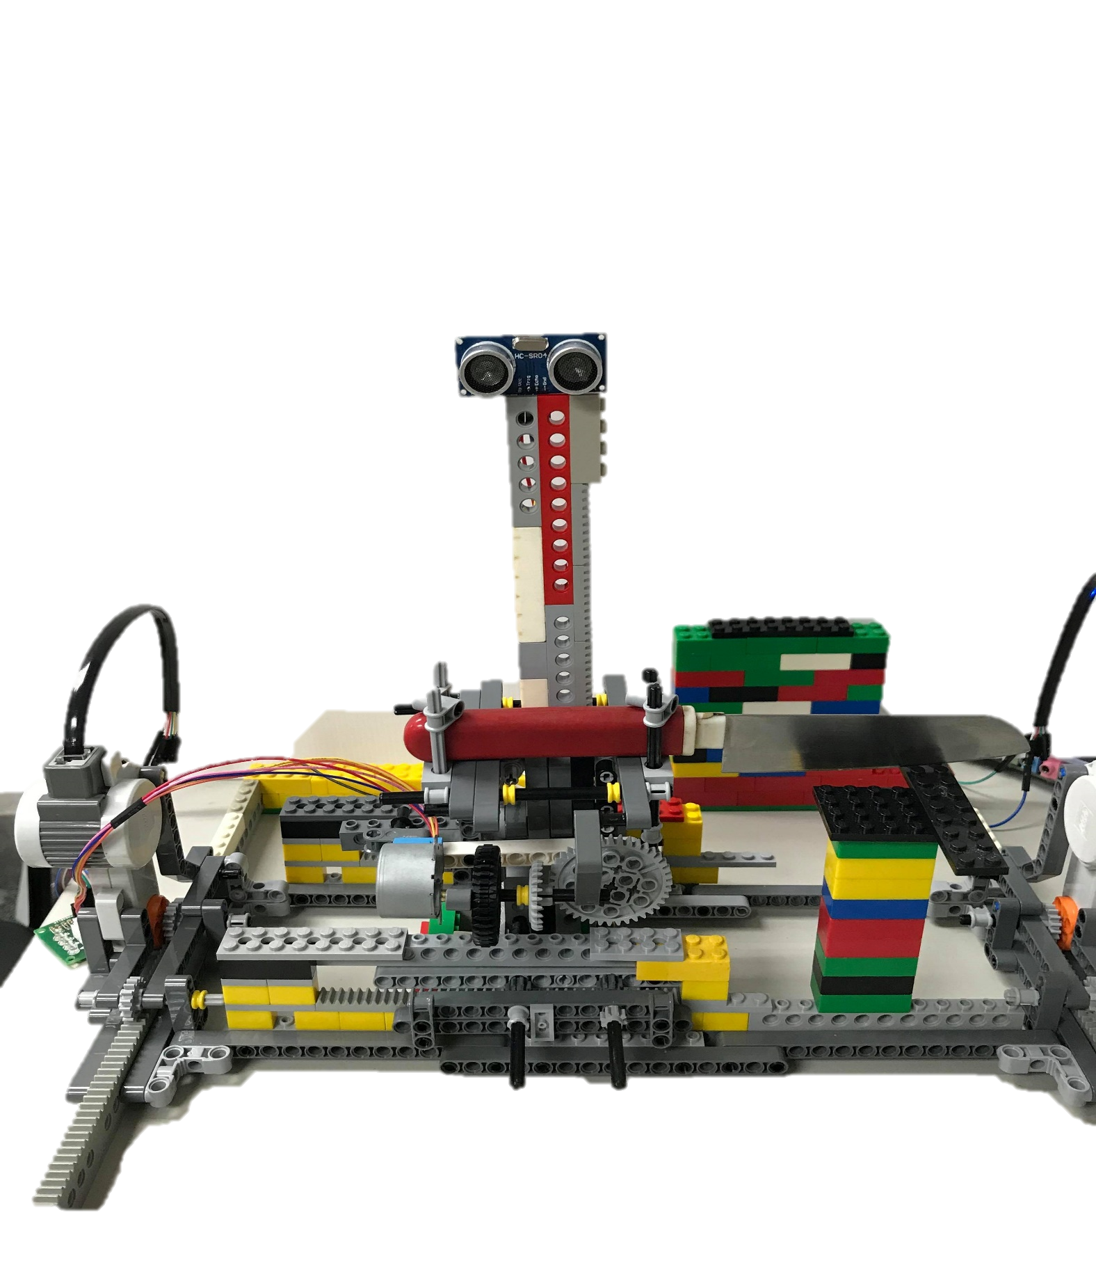
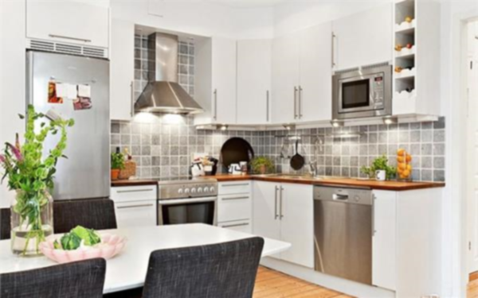

Slide 7
Functionalities
A. Automatically Cut Things
This machine will automatically cut everything you want.
B. Cut Things Into Slices
Based on your settings, you can choose how many slices you want to cut.
C. Cut things very equally
This machine will automatically detect the distance between it and things you want to cut. Meanwhile, it calculates the distance and decide where to cut so that it can cut things equally.
Notes:
這就是我們自動切菜機的宗旨，我們建造一個機器負責自動幫那些辛勞煮飯的人可以自動切菜，他就有更多時間可以做其他事情。而除了這個功能，他還可以選取他想要將東西切成幾分

Slide 8
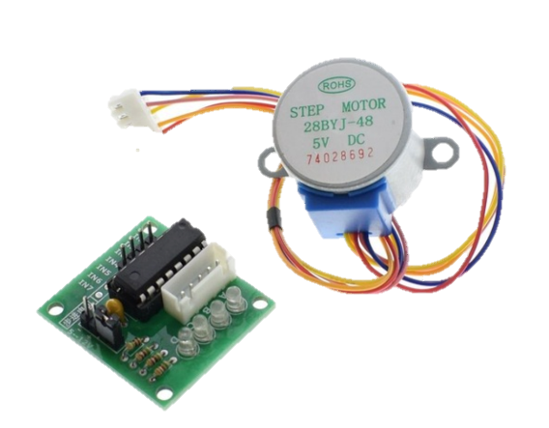

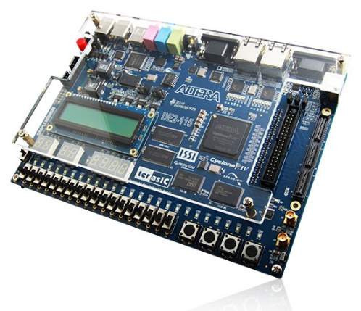
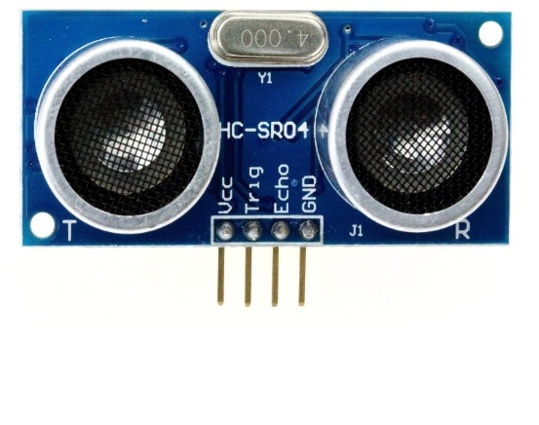
Electronic Elements
A. Step Motor
B. Ultrasonic Detector (HC-SR04)
C. LEGO
D. FPGA
To make the knife move up and down and move the plate forward and backward.
To measure the distance between the sensor and the object you want to cut
To build the substrate of the machine
To drive all the electronic elements

Slide 9
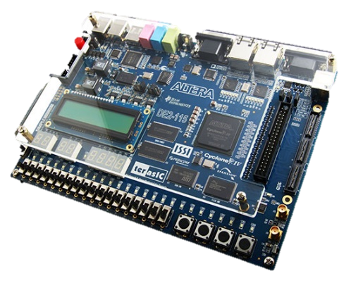
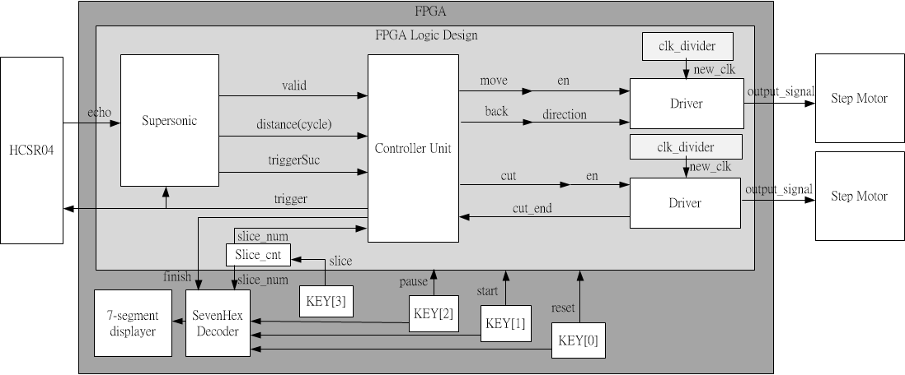
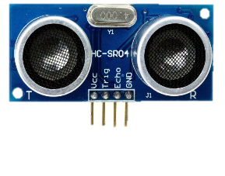
Hardware Architecture

Slide 10
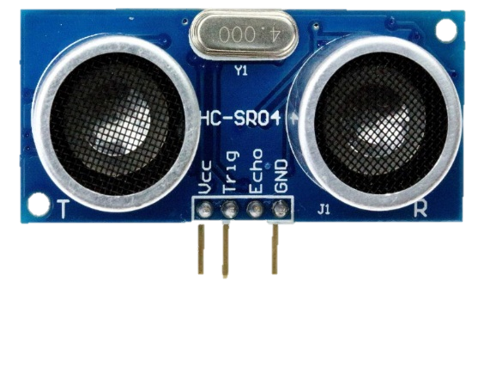
HC-SR04
A. Exact Trigger Time
Send ‘trigger’ until detecting the rising edge of ‘echo’
-> HC-SR04 seems to have intervention and stuck on triggering stage
We send ‘trigger’ for exact 500 cycles ( 10 μs).
B. Enough Space Time
If the space time between two triggering is too short, HC-SR04 will stuck on triggering stage.
We set space time to be 50 ms.

Slide 11
Detail of Controller
A. Move
At first, we only move when the HC-SR04 is waiting for ‘echo’.
However, this time is too short for plate to move (above 2 ms).
Therefore, we also move when HC-SR04 is being triggered. (The speed of the plate is not so high that it won’t influence the performance.)
B. Cut
When the machine move to the ideal distance which is calculated by FPGA, the controller will sent cut signal to cut driver to make cut motor start cutting.

Slide 12

DEMO TIME

